Slide 1
Traveler Sales Man Problem
Presented by:
Luke Clarke
Juan Resusta

Slide 2

What Is The Traveler Sales Man Problem?
N!

Slide 3
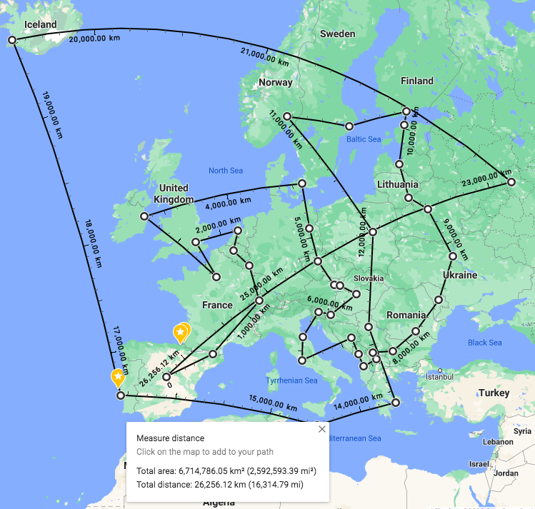
Our First Approach
Results:
Insight: The result is a circle

Slide 4
Insight
It’s A Circle!

Slide 5
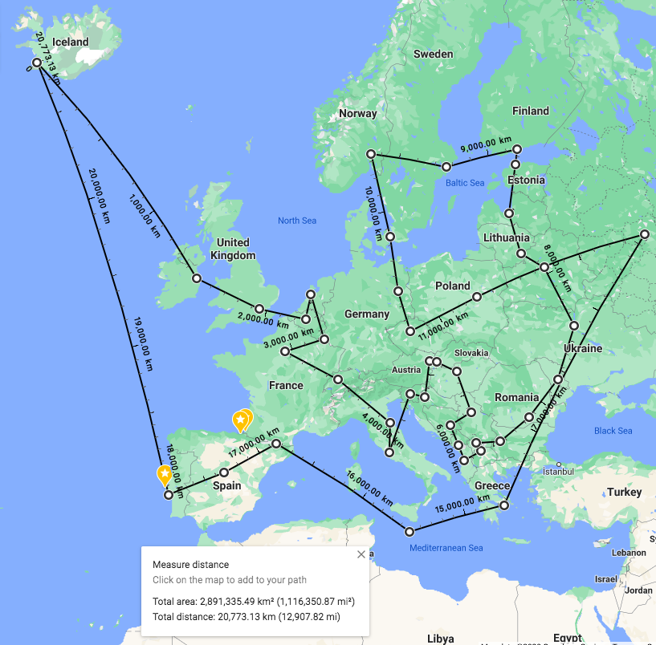
Our Second Approach
Results 2:

